Slide 1


Sepsis Analysis and Prediction
Jay Khatri – 160280107038
Adarsh Shah – 160280107097
Rushi Shah – 160280107105
Mentored by
Prof. Zishan Y. Noorani

Slide 2
Why ?
There are too many manual processes in medicine. While doctors are under training they have to prescribe from lab values , diagnoses and other chart notes.
Healthcare industry generates piles of data which contains information like medical records of patients , clinical measurements , body fluids , imaging reports , survival data, and more.

Slide 3


Slide 4
What is Sepsis ?
Sepsis is life threatening condition caused by body’s response to an infection. Body normally releases chemicals into the bloodstream to fight an infection. Sepsis occurs when body’s response to these chemicals is out of balance, triggering changes that can damage multiple organ systems
A study published in 2016 reported that nearly 1/3rd of patients admitted into ICU in india had sepsis and one in three of these patients died ! (courtesy: livemint.com)

Slide 5
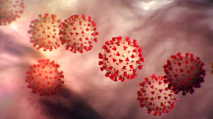
Yes, sepsis can be caused by covid19
Covid19 hijacks immune system and reprogram it to cause damage to host,
Which leads to organ failure and causes death

Slide 6

What about data ?
MIMC III – dataset is widely used internationally in areas such as academic and industrial research.

Slide 7
Tools used
Python language version 3.6.0 or above
Tensorflow framework 1.1.0 or above
Postgresql database server
GPU if available to increase the computation speed
DeepLearning4j and ND4j
Github
Servlets & JSP
HTML, CSS, JS
Bootstrap, Jquery, AJAX

Slide 8
Finding meaningful data
From few research papers we concluded that from this huge pile of only 96 parameters which includes urinal data , ICU readings , gases dissolved in blood , compounds in blood etc.
Running SQL to find patients who had sepsis and storing it locally.

Slide 9
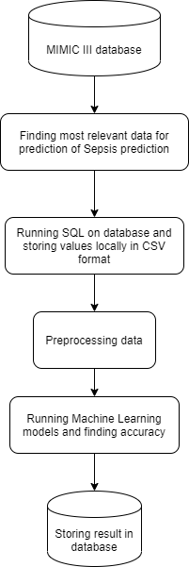
How it works
We made 6 layer deep neural network model which takes 96 parameters from stored CSV file.
We used 80% data for training and 20% for testing.

Slide 10
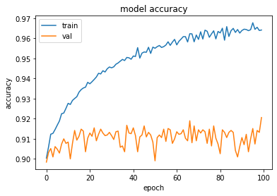
Accuracy scores of NN
F1 Score : 74.78%
Recall Score : 61.31%
Precision Score : 95.83%

Slide 11
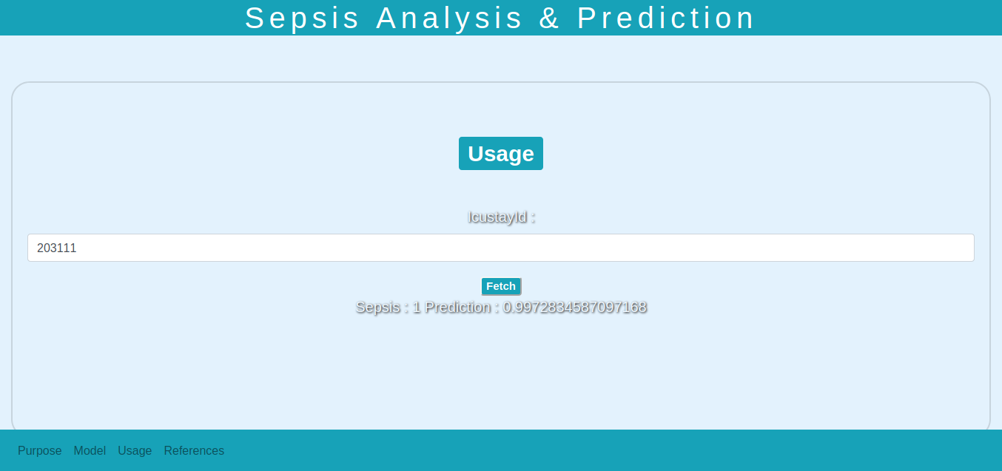
Web Portal

Slide 12
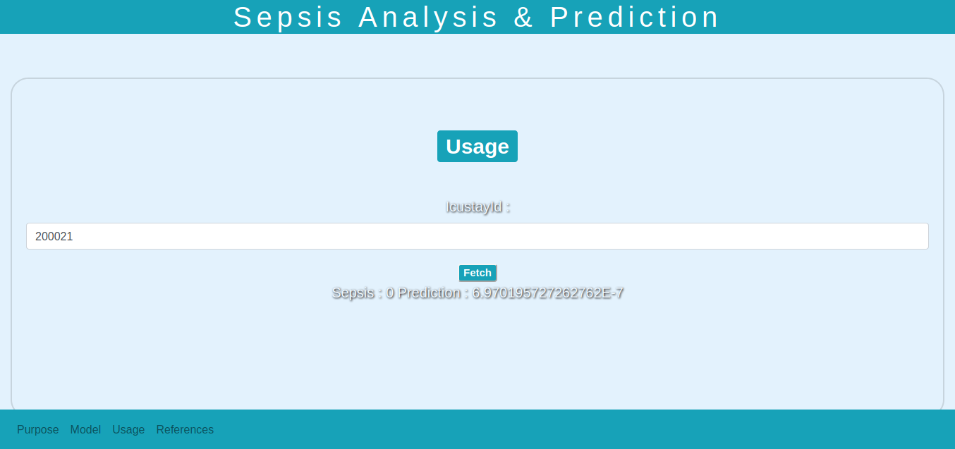
Web Portal

Slide 13
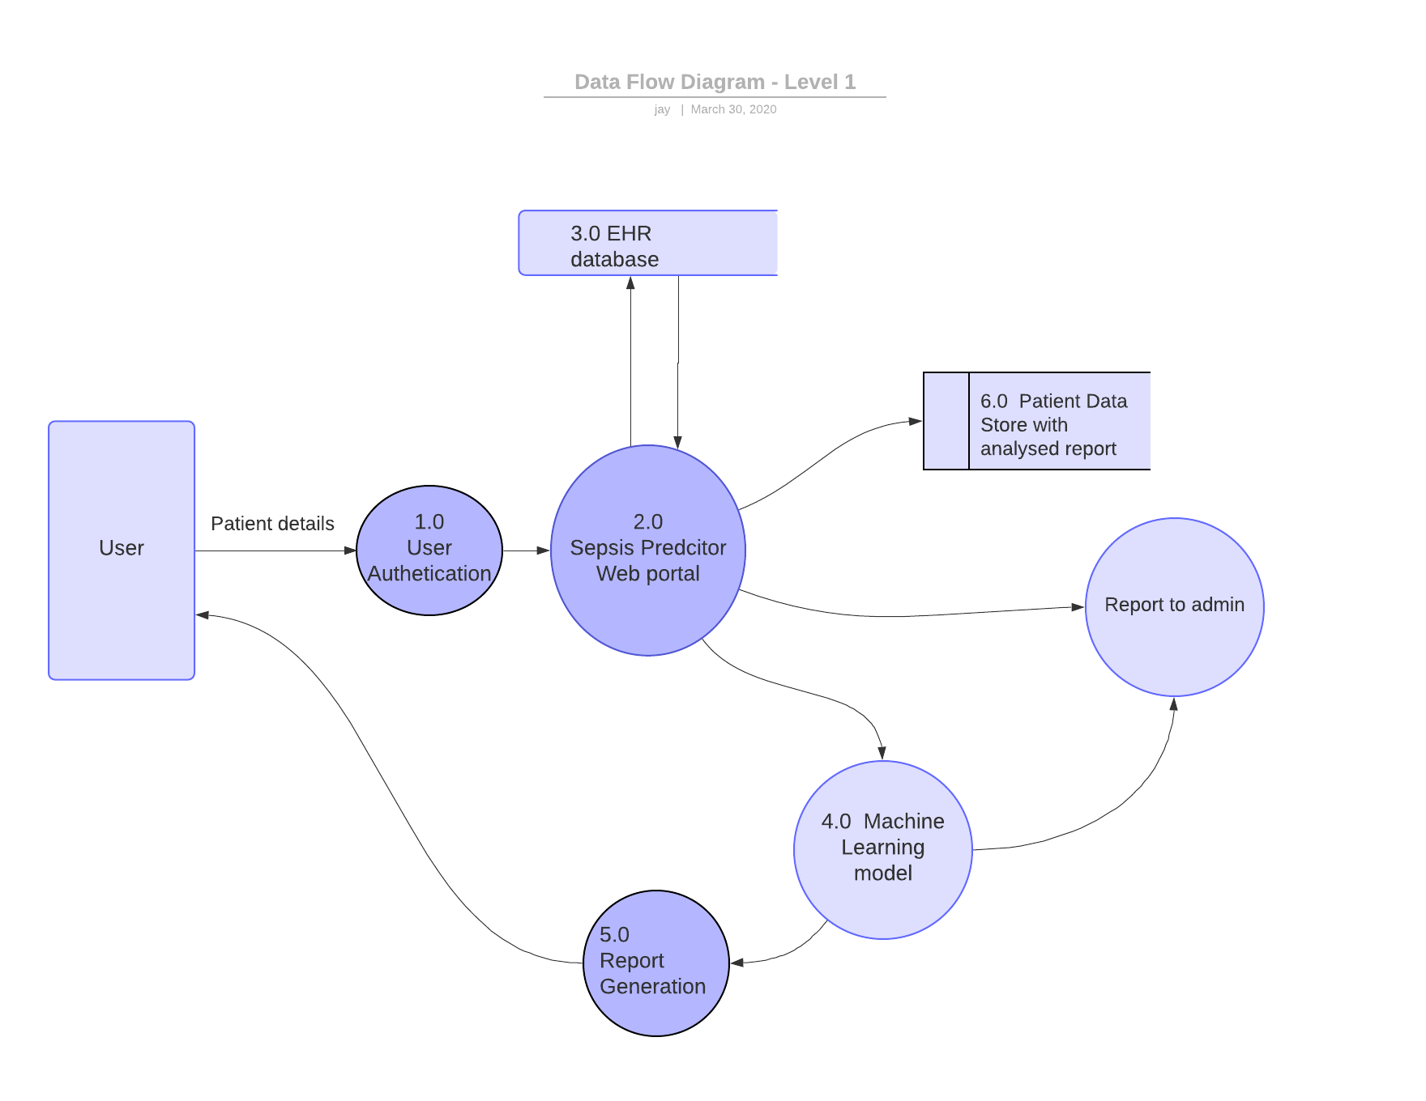

Slide 14
Thank You

